Slide 1
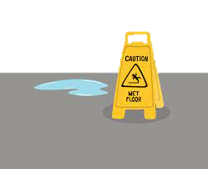
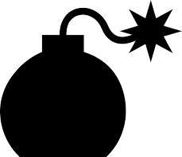
CAPA MANAGEMENT PROCESS
complaint
OOS product
CAPA?
Record
Review Data
Risk
Assessment
Containment &
Correction
NO→ Close, Track & Trend
YES → Open CAPA
non-conformity
audit
deviation
Effectiveness
Check
CAPA Opened
Investigate
(if unknown cause)
Root Cause
Analysis
Plan
Approve
Correct
PASS → CAPA Closed
FAIL→ Repeat CAPA

