Slide 1
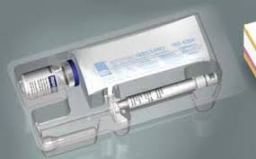
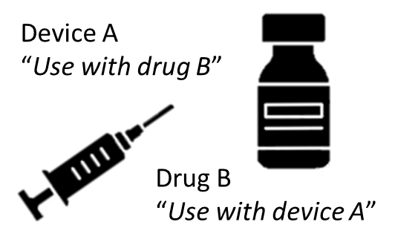
COMBINATION PRODUCT TYPES
SINGLE ENTITY
Parts chemically or physically combined
CROSS-LABELED
parts sold separately
CO-PACKAGED
parts sold together
Notes:
Types of Combination Products

