Slide 1
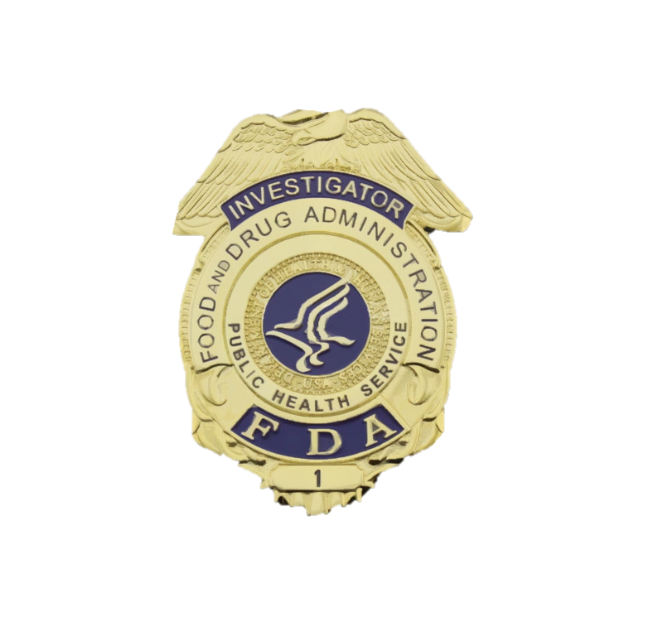
Notes:
FDA Badge

